Slide 1
Data Visualization & Interpretation
Febin.A.Vahab

Slide 2
VISUAL ANALYTICS

Slide 3
PLAN
UNDERSTANDING DESCRIPTIVE STATISTICS
REFERENCE OBJECTS
TREND LINES and FORECASTING
BOX PLOTS
CLUSTERING
SETS

Slide 4
SUMMARY CARD

Slide 5
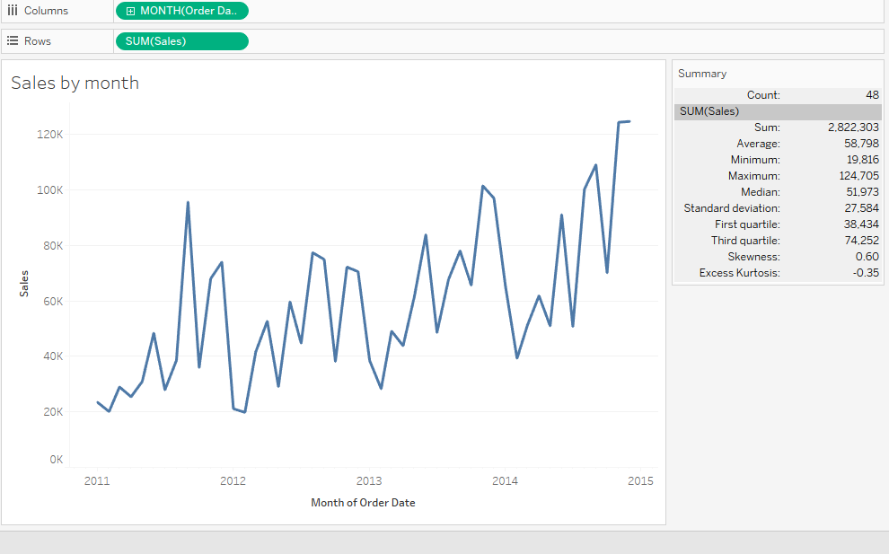
WORKSHEET SUMMARYCARD

Slide 6
AVAILABLE STATISTICS
DEFAULT
COUNT
SUM
AVERAGE
MINIMUM
MAXIMUM
MEDIAN
ADDITIONAL
SD
FIRST QUARTILE
THIRD QUARTILE
SKEWNESS
EXCESS KURTOSIS

Slide 7
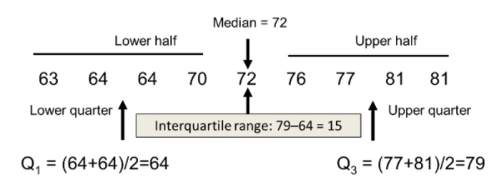
QUARTILES

Slide 8
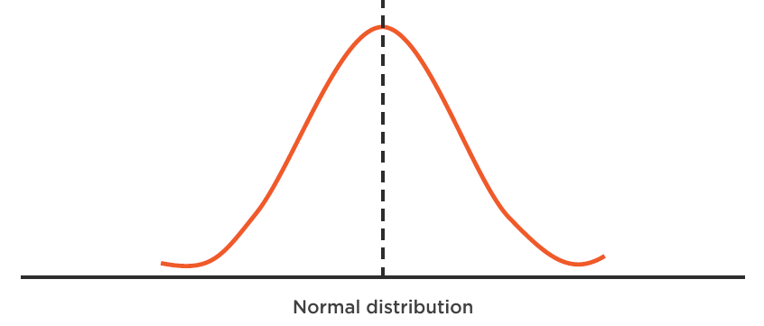
Skewness

Slide 9
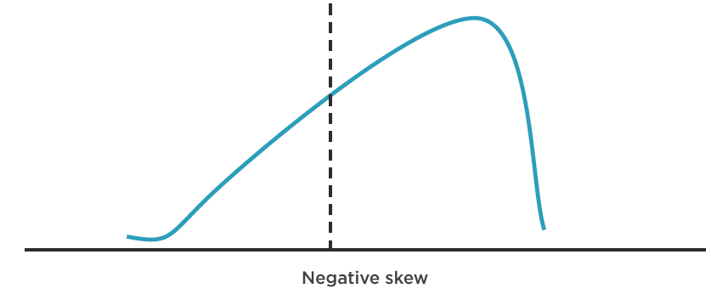
Skewness

Slide 10
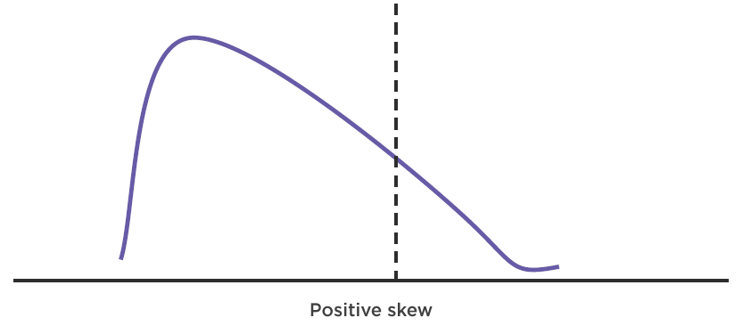
Skewness

Slide 11
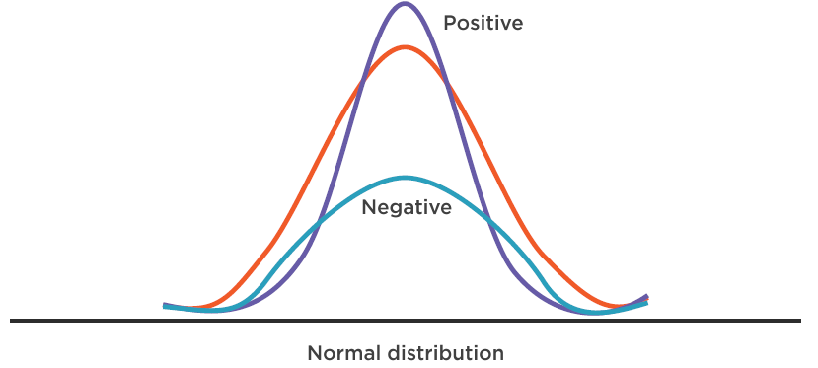
Kurtosis

Slide 12
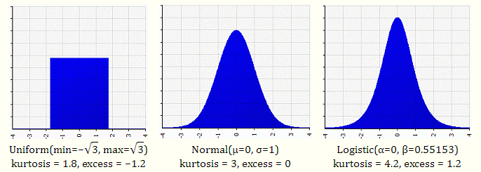
Kurtosis

Slide 13
DEMO
Analyze sales by month for global superstore
Simple exercise to understand skewness and kurtosis

Slide 14
REFERENCE OBJECTS

Slide 15
REFERENCE OBJECTS
A reference object is a line, band, or distribution used to identify a specific value, region, or range on a continuous axis in a Tableau view

Slide 16
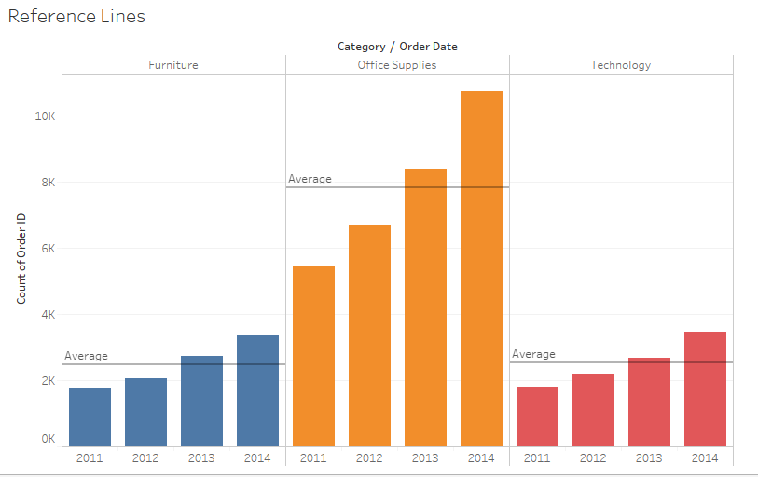
REFERENCE LINES

Slide 17
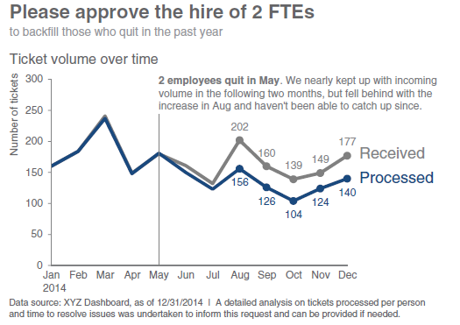
REFERENCE LINES

Slide 18
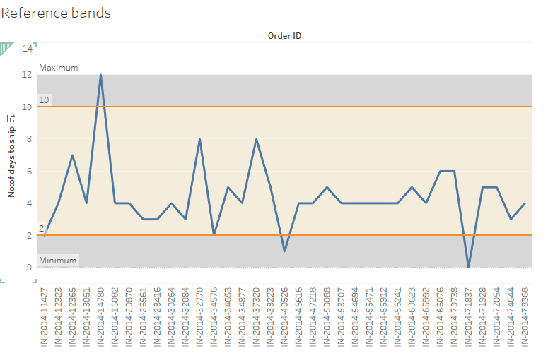
REFERENCE BANDS

Slide 19
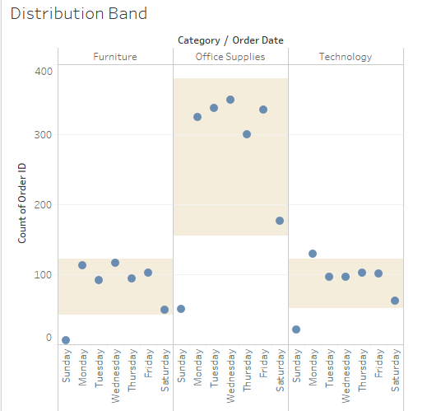
DISTRUBUTION BANDS

Slide 20
DEMO
Analyse the number of orders per category for each year. [Reference Line]
Recreate the Decluttering Case study 3[Approve the hire of 2 FTEs] in Tableau [Reference line]
Demonstrate in a visual, in 2014, how many Phone orders from India were shipped within the ship day time limits which is 2-8 days?[Reference band]
Dig in deeper into the orders received by weekday for each category , for 2014,April [Distribution Band]

Slide 21
BOX PLOTS

Slide 22
BOX PLOTS
Use box plots, also known as box-and-whisker plots, to show the distribution of values along an axis.

Slide 23
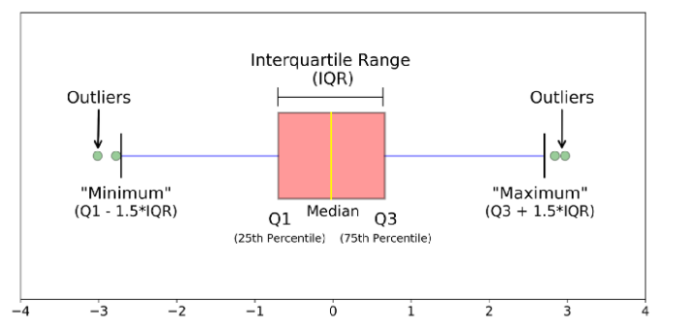
BOX PLOTS

Slide 24
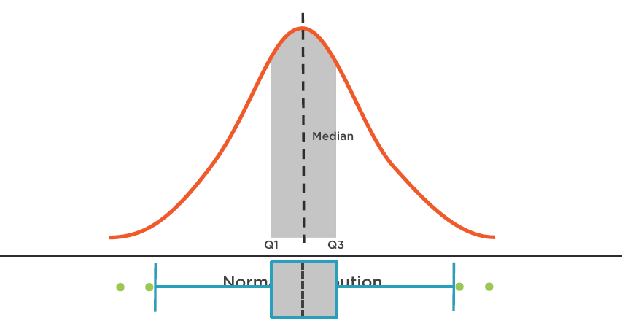
Underlying Data Shape

Slide 25
DEMO
What is the spread of average discount given for each segment in each region?
What is the rate of change of sales over the years for Global Superstore? By how much and what is the variation in between years?
Use Iris Data Set for a through understanding

Slide 26
Confidence Interval

Slide 27
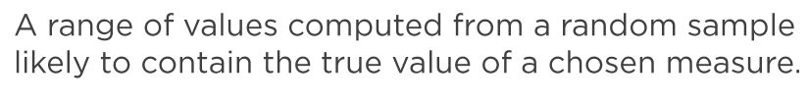
Confidence Interval

Slide 28
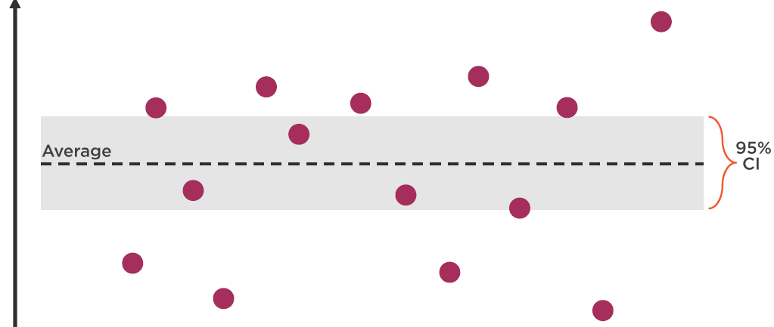
Confidence Interval

Slide 29
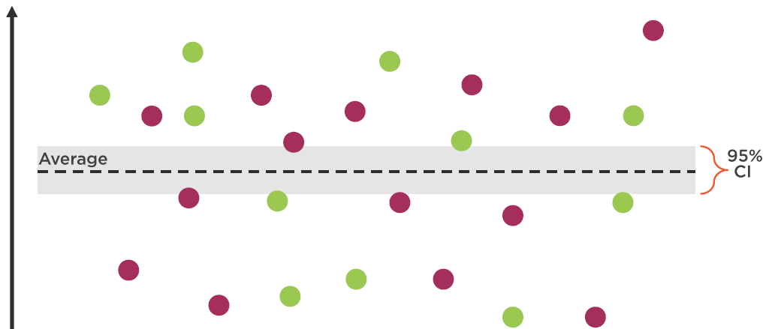
Confidence Interval

Slide 30
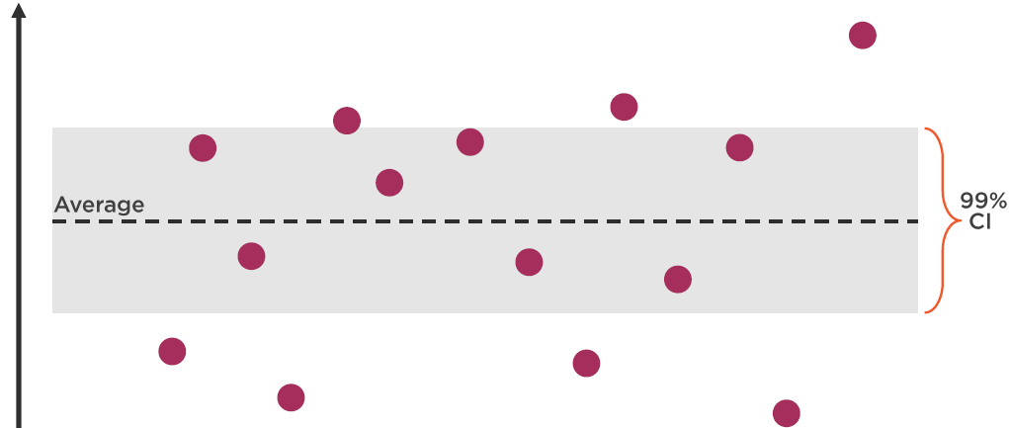
Confidence Interval

Slide 31
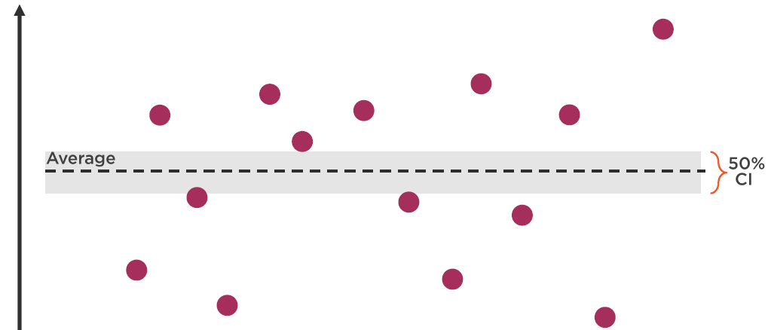
Confidence Interval

Slide 32
DEMO
Identify the confidence interval for average sales for furniture category, in 2014?

Slide 33
Trend Lines

Slide 34
Trend Lines
A trend line as a line added to a chart showing the general direction of data or the relationship between numeric data

Slide 35
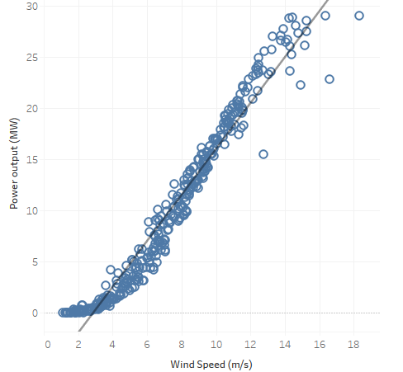
Trend Lines

Slide 36
Trend Lines
3 Components
Equation
R-Squared
P-Value

Slide 37
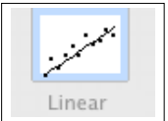
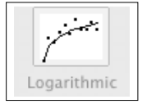
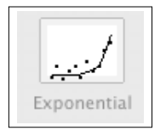
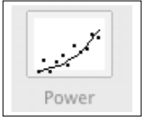
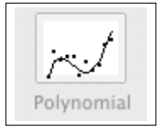
Equation
Linear :Y = b0 + b1 * X
Logarithmic :Y = b0 + b1 * ln(X)
Exponential :Y = exp(b0)* exp(b1 * X)
Power :Y = b0 * X^b1
Polynomial :Y = b0 + b1 * X + b2 * X^2 + …

Slide 38
R-Squared
Number between 0 and 1 that describes how much variability in the Y can be explained by X
Closer to 1 indicates better fit.

Slide 39
P-Value
Probability that the output trend line was caused by random chance
Smaller is better
https://help.tableau.com/current/pro/desktop/en-us/trendlines_add.htm

Slide 40
Thank You!

